Slide 1


ANON
Final Review

Slide 2

Project Guide
Dr. Nageswara Guptha M
Senior Associate Professor

Slide 3
Team Members
VARDAAN VISHNU (C) – 19BCE10063
SHIKHAR VASHISHTHA– 19BCE10025
PRANTIK BHATTACHARJEE – 19BCE10222
PRASHANT CHAUHAN – 19BCE10280

Slide 4
Introduction
Anon aims to be one of a kind app that will facilitate WhatsApp Messaging and WhatsApp Calling without having to save the recipients contact info
This idea originates from people’s need for quick messaging to unknown contacts, on the go!

Slide 5
Proposed work
The various features we wish to add to our app are:
Messaging in WhatsApp, without saving contact info
Temporarily saving contact info within app for later use
Ability to backup chats with unknown contacts

Slide 6
Existing work with limitations
ANON is easy use.The thing that makes it attractive is its ease of use, free of cost. It can serve as a great platform for some humanitarian purposes without any threat to privacy. For instance – Raising of social issues, counselling purpose, communication with senior citizens etc.
There can be limitation also with its use:-
People often doubt for its addless service, making them think about threat of Data Security.
People might misuse it for spamming unknown contacts.

Slide 7
Novelty of ANON
The Idea for this project arises from ‘WhatsApp public API documentation’ which stated an API that could create chat links with a given Contact
Novelty or Originality of concept remains the essence of this project
We will try to make our project as Original & Innovative as possible by constantly adding our own innovative ideas

Slide 8
Real Time Usage
How our app can be used in real time scenario
1. We being students can send any assignment or tutorial related work to anyone without saving the number as our app is meant for these purposes only.
2. When WhatsApp will start digital transfer of money, then we can transfer money without saving the contact info, for faster transactions.

Slide 9
Hardware & software requirements
Hardware Requirements-
Our app ANON will require a mobile device to operate
The web version(WhatsApp Web)that will require a laptop or a desktop to operate
Software Requirements-
ANON uses API 24 & above thus requires Android Operating System newer than Marshmallow 5.1 upto Android 11
We can use any browser that can run latest HTML & CSS scripts

Slide 10
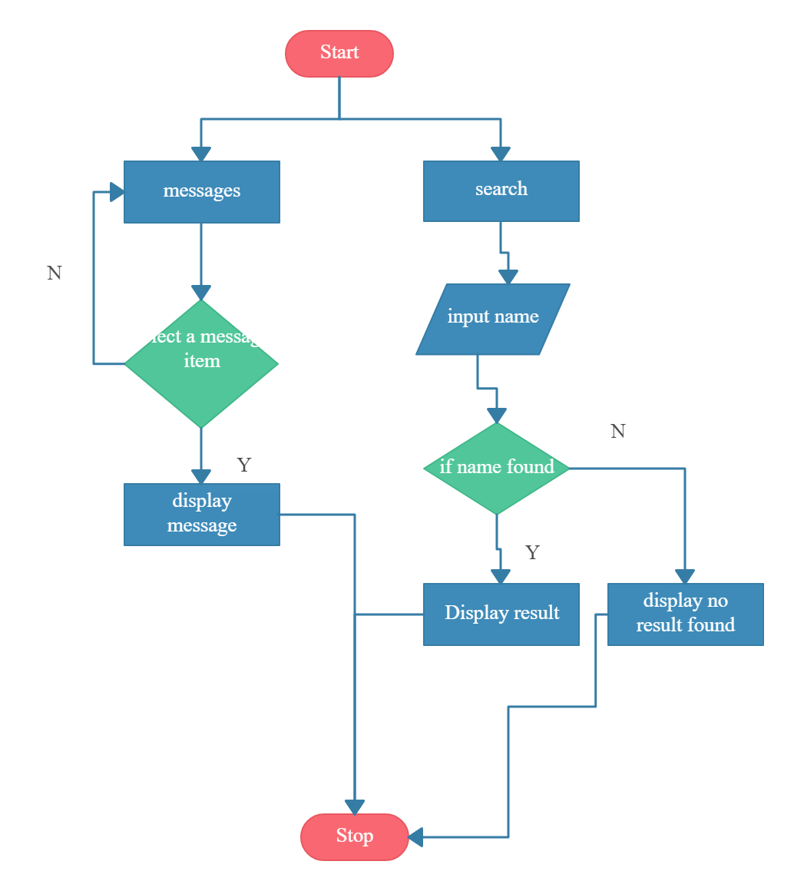
Module Work Flow

Slide 11
Module Description
Type the number whom you want to send the SMS with country code, through WhatsApp Web or Android app.
WhatsApp public API is called in the application.
Server systems do the backend message routing.
WhatsApp server start from ejabberd, a famous open source server.
The successful retrieval of a message is sent back to the WhatsApp server which forwards this status back to the original sender
Material Design Lite Library is used in this app which lets us add a Material Design look and aims to optimize for cross-device use

Slide 12
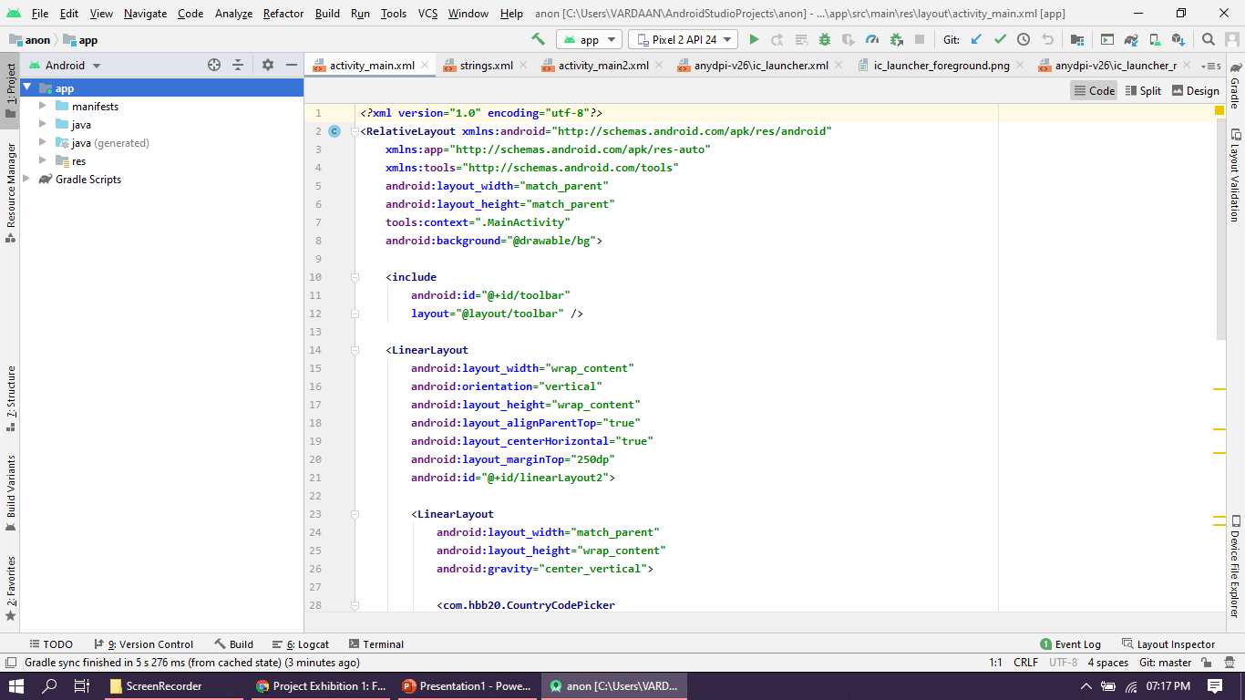
Implementation & Coding

Slide 13
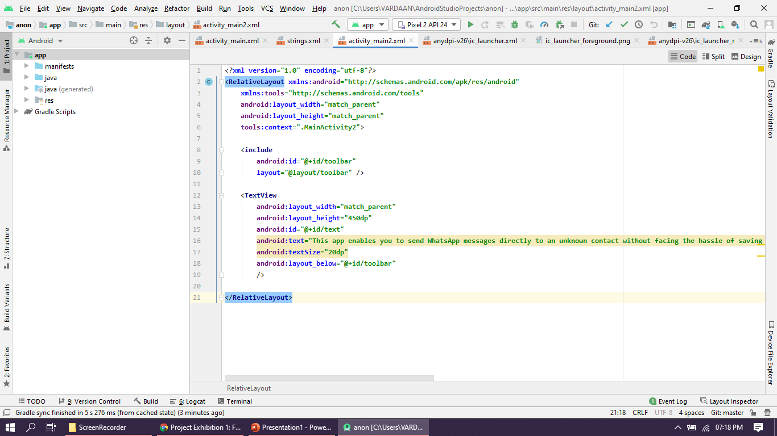
Implementation & Coding

Slide 14
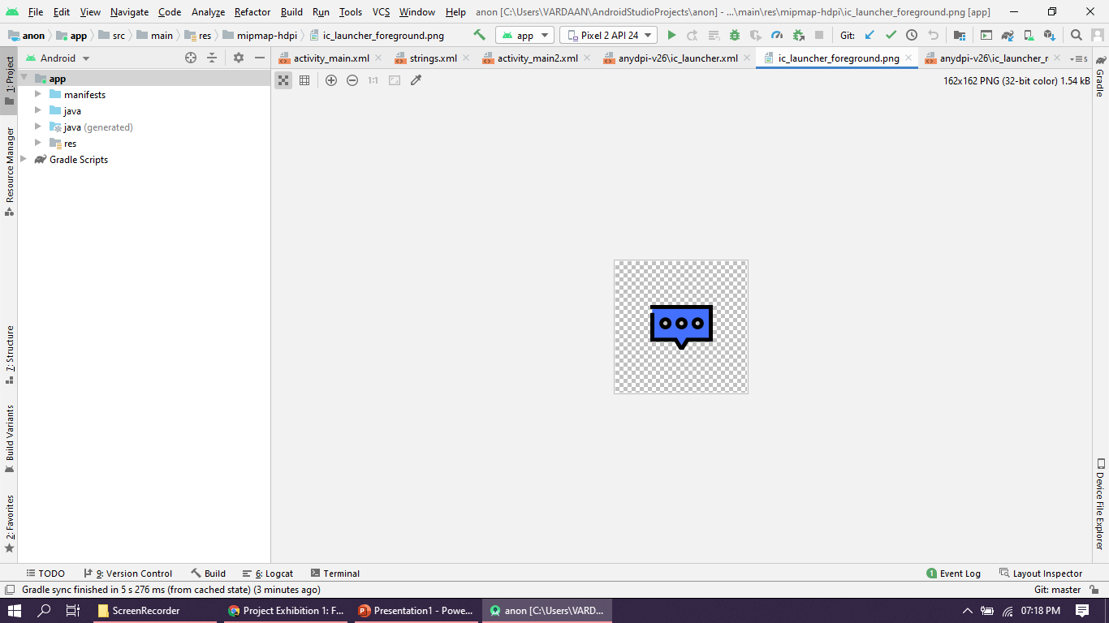
Implementation & Coding

Slide 15
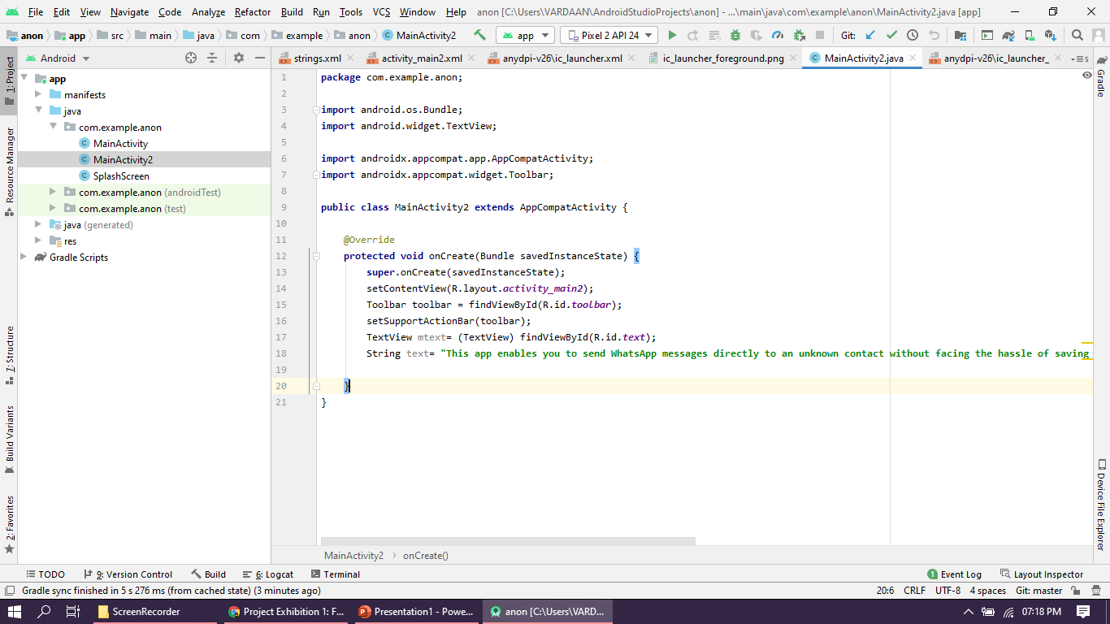
Implementation & Coding

Slide 16
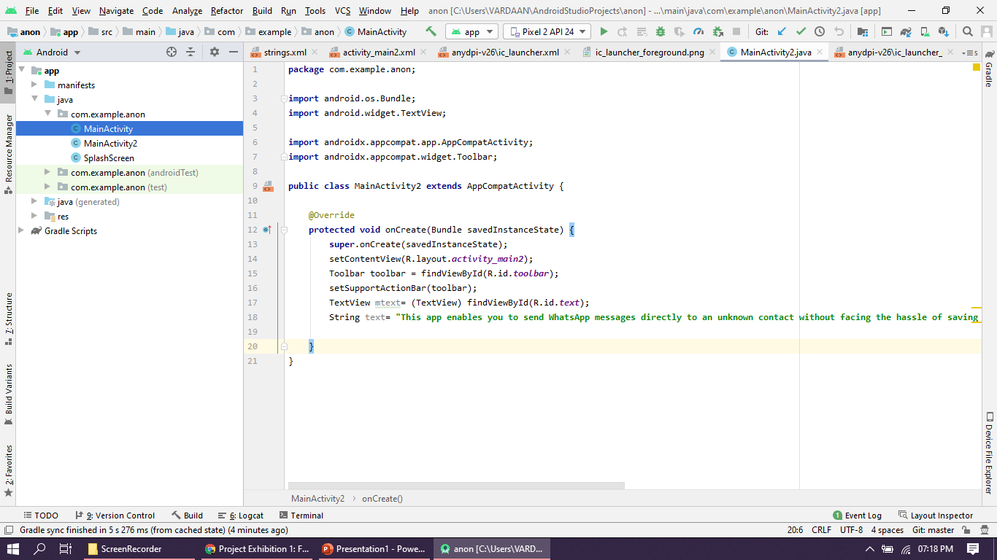
Implementation & Coding

Slide 17
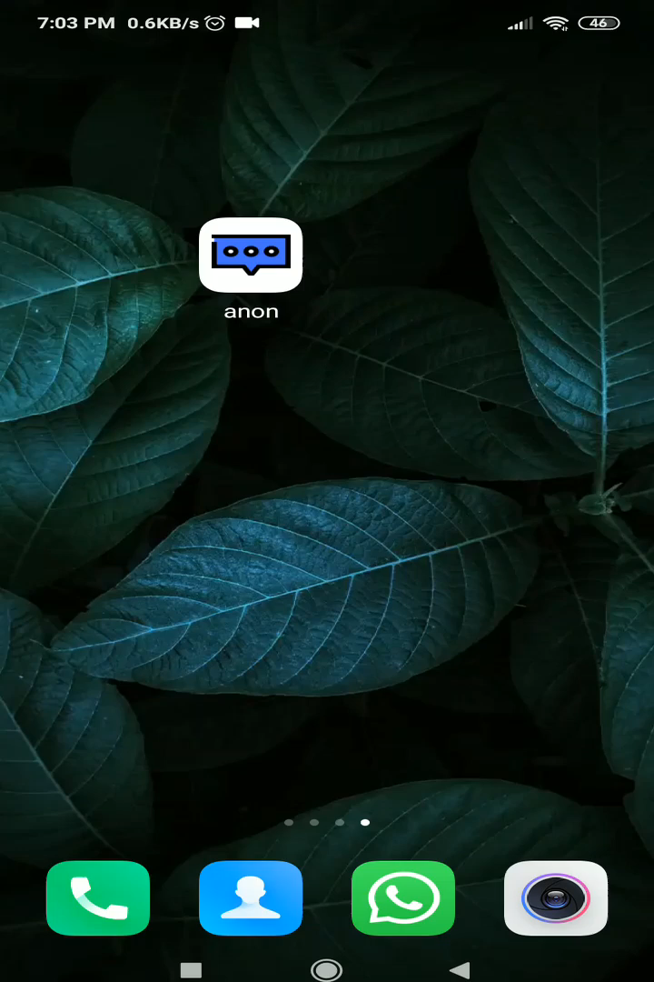
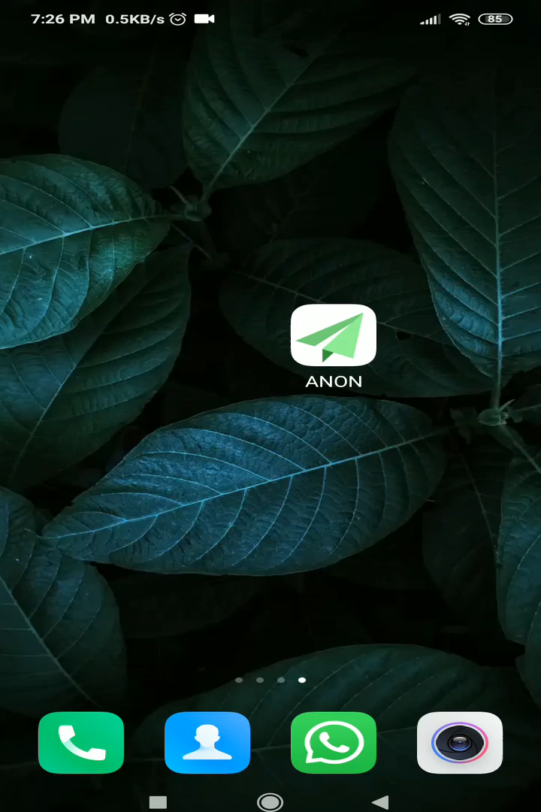
Demo

Slide 18
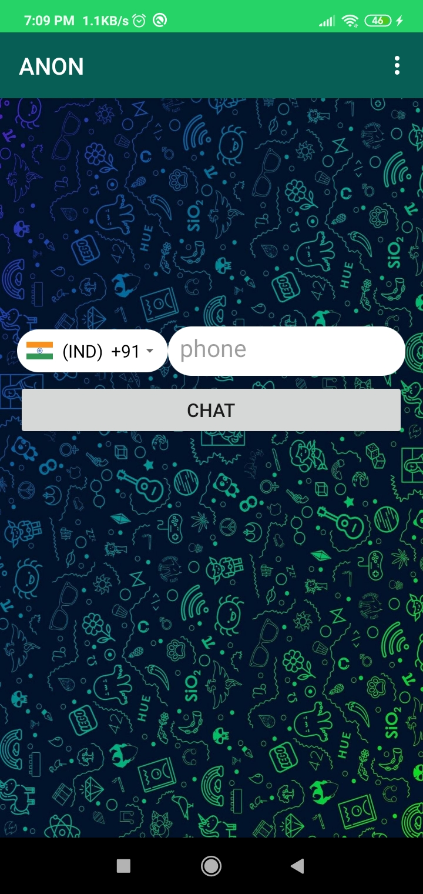
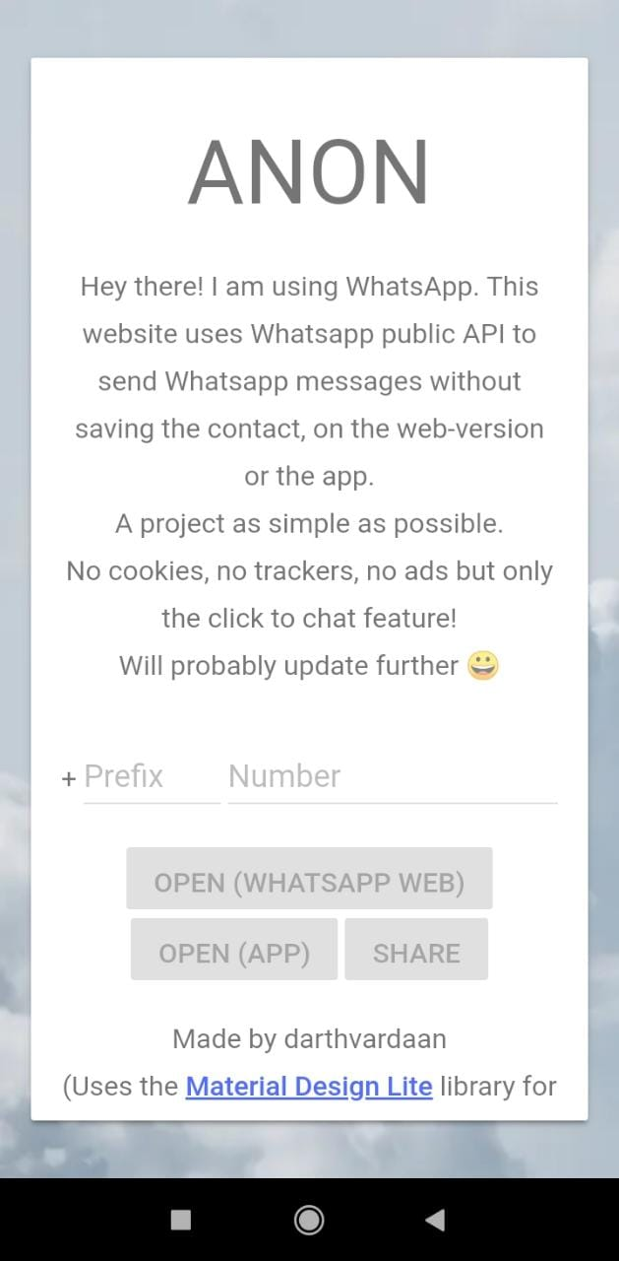
Snapshot

Slide 19
Conclusion
Thus we can conclude here that ANON’s Android Native App, ANON’s Web App as well as ANON’s Website, all are functional and till now have 0 downtime to them. They all use the same API base and the team has tried to code the application modules in such a way that ANON reaches out to more and more people

Slide 20
THANK YOU!

